Slide 1
Latent Semantic Analysis
and other NLP clustering techniques
Abhishek Rengarajan and Kiran Ganeshan

Slide 2
Introduction
One of Natural Language Processing’s big goals is discerning ideas from bodies of text
Ex. “John and Bob are ecstatic” vs “Bob and John feel happy” both convey the same idea even the words are distinct
Using techniques similar to PCA, we will attempt to reduce from the high dimensional space of words to the lower dimensional space of ideas
2 big ideas that attempt to do this
Word2Vec
Latent Semantic Analysis

Slide 3
Word2Vec
Words can be thought of as weighted combinations of other words
Ex. A “male queen” is a king. Alternatively, male+queen=king
In the example we have equally weighted the both ‘man’ and ‘queen in the equation, but this isn’t necessary
Note that the linguistic equation satisfies general mathematical properties
Ex. king-male=queen plausibly makes sense

Slide 4
Word2Vec - Mathematics
The Distributional Hypothesis tells us that words that appear in similar frequency and similar locations are generally synonymous with each other
Therefore a word contextually defines the words before and after it
In mathematical terms, using 2k as the number of context words being used

Slide 5
Word2Vec - Mathematics (Cont.)
Seeing a word represented as a linear combination of the words around it, we can use a one-hot encoding of the word and multiply it by an mxn matrix W then a nxm matrix W’
After applying a softmax, the output will be a probability distribution of each word
This is called the skip-gram model
However, W corresponds to a neural net that takes has n inputs, n outputs and a hidden layer with m neurons!
The correct output is 1/2k at each of the 2k correct context words
Then we can train a standard neural network using these labels!

Slide 6
Word2Vec - Mathematics (cont.)
How does a neural network correspond to a low-dimensional subspace embedding?
In short, it doesn’t. So what’s the plan?
Well note that a one-hot encoding is sparse, so the first matrix W is just a lookup table where our i-th column is our mapping to an m-dimensional vector
This vector is our m-dimensional embedding!
There is a similar method to skip-gram trains a neural network to take in a bunch of context words to predict the missing word that is extremely similar

Slide 7
Latent Semantic Analysis
Maybe we don’t want a word low-dimensional embedding, we want to discern underlying topics in a document
This seems extremely similar to PCA in that we want to find some underlying latent structure that generates a high-dimensional space
In fact, we will use a very similar technique

Slide 8

Latent Semantic Analysis - Mathematics
We need a matrix to perform PCA, so our matrix will be a document-term matrix D
D_{i,j} is the number of instances of word i in document j
Then we calculate
To get a k-rank approximation we can calculate

Slide 9
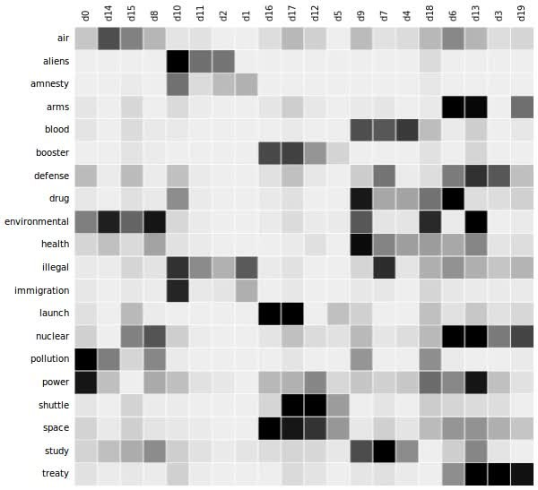
Document-Term Matrix

Slide 10
Latent Semantic Analysis - SVD
In the SVD, U represents a matrix with the rows representing the words and the columns representing the documents
Sigma_{i,i} represents the important of topic i
V is a topic prevalence matrix where the entries are the number of times that a topic appears in each document

Slide 11
Latent Semantic Analysis - Shortcomings
Mathematically, corresponding to this SVD, we should think of the basis vectors of our rank k approximations as the ideas/topics
So a basis vector might be 0.3*happy-0.4*sad which would correspond to the idea of happiness
However, we should not place too much faith in this as another basis might be 0.3*happy+0.4*bottle which is not easily interpretable

